Slide 1
The many facets of Natural Computing - Review
Jean Carlo Machado e Renato Bustamante

Slide 2
Meta
Lila Kari and Grzerog Rozemberg Communications of the ACMA, 2008

Slide 3
General Subject
Natural computing introduction for Computer Scientists

Slide 4
Specific Subjects
Describes fields in which the natural phenomena is abstracted to solve human problems

Slide 5
Specific Subjects
Describes fields in which the natural phenomena is abstracted to solve human problems
Where these methods can be implemented.

Slide 6
Specific Subjects
Describes fields in which the natural phenomena is abstracted to solve human problems
Where these methods can be implemented.
And looks to understand understand biology as information processing.

Slide 7
Classical use of CN
▶ Cellular automata
▶ Neural networks
▶ Evolutionary computation

Slide 8
New areas
▶ Swarm intelligence
▶ Artificial immune systems
▶ Artificial life
▶ Membrane computing
▶ Amorphous computing

Slide 9
Key points

Slide 10
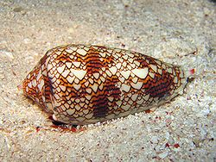
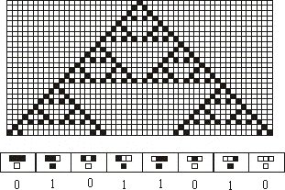
Cellular automata
A cellular automaton is a dynamical system consisting of a regular grid of cells.
Each cell changes its state according to a list of given transition rules that determine its future state, based on its current state and the current states of some of its neighbors.
Autómatos celulares naturais

Slide 11
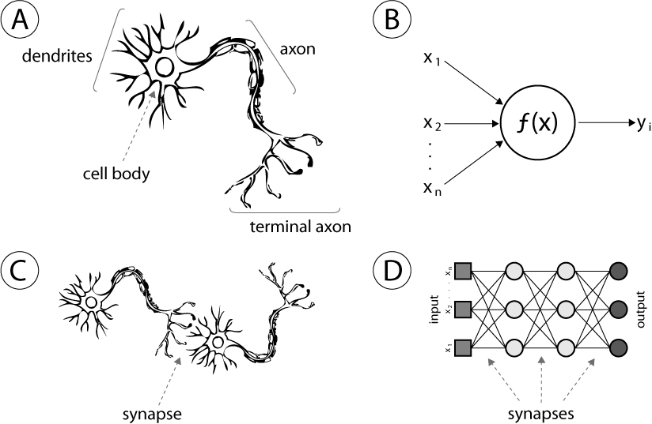
Neural Networks
Three important features of neural networks are: function of each neuron, the topology of the network, the learning algorithm to change the weights
Backward propagation[k]

Slide 12
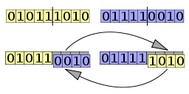
Evolutionary Algorithms
Evolutionary algorithms gained momentum on 60ties.
Uses mechanisms inspired by biological evolution, such as reproduction, mutation, recombination, and selection.
Good for real valued, discrete and mixed types of parameters.
Genethic Algorithms
Genetic algorithms use strings to represent the genetic material.
Good for real valued, combinatorial tasks.

Slide 13
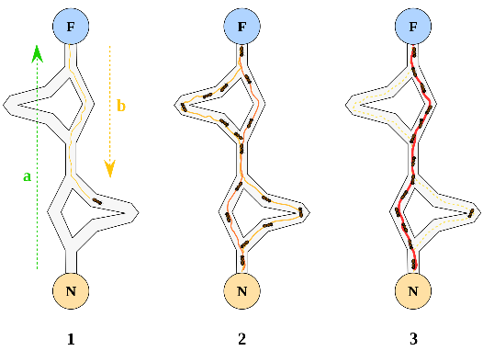
Swarm Algorithms
The velocity of the particle in a swarm algorithm depends on it’s previous velocity (inertia). There’s a good balance between global best and local best.
Applied on unsupervised learning, game learning, scheduling and planning applica- tions, and design applications.
Ant algorithms have been used to solve combinatorial optimizations defined over discrete search spaces.

Slide 14
Artificial Immune systems
Artificial immune systems uses learning, memory, associative retrieval to solve recognition and classification problems. Often called second brain.
Parts of the immune system: innate (non-specific) and adaptive (acquired).
Used in computer virus detection, anomaly detection, fault diagnosis, pattern recog- nition, machine learning, bioinformatics, optimizations, robotics and control.

Slide 15
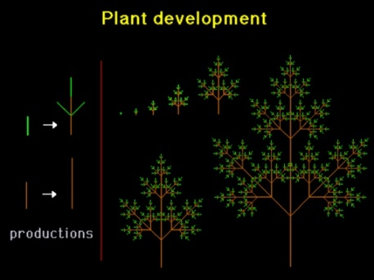
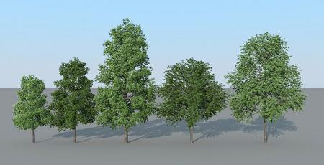
Artificial Life
Artificial systems try to imitate the whole “living organism”. Lindenmayer systems (L-systems) 1968, are the first research in artificial life. Used in model plant growth and development and modeling the morphology of other organisms.
Evolving virtual blocks creatures (36), selected for their ability to swim.

Slide 16
Membrane Computing
Membrane computing studies the compartmentalized internal structures effected by membranes. Uses include computer graphics, public-key encryption, approximation and sorting algorithms, linguistics.
Amorphous Computing
Amorphous programming has been used as a computing paradigm. The goal is to engineer specific different types of hardware. There’s only local communication.

Slide 17
Quantum computing
Feynman first suggested a quantum computer in 1982. A qubit can hold 0 or 1 or a quantum superposition of these. A quantum computer operates by manipulating those qubits with quantum logic gates.
144km experiment of quantum criptography on Cannary islands
Shors quantum algorithms quantum teleportation transports quantum states (not energy or matter) to an arbitrary location.
Quantum algorithms where shown to have a quadratic time advantage when com- pared to classical algorithms by Grovers.

Slide 18
Biological Systems
In 1960 Jacob and Monad discovered mathematical logic in gene regulation.
Systems biology focus on the interactions between biological networks. Research had focused on DNA, RNA, proteins, lipids, carbohydrates and their building blocks.
1994 - the first DNA computing experiment by Adleman use of DNA as a form of computation which solved the Hamiltonian path problem.
People already generated the synthetic genome of a virus in 14 days by synthesized short DNA strands.

Slide 19
Biological Systems
In 1960 Jacob and Monad discovered mathematical logic in gene regulation.
Systems biology focus on the interactions between biological networks. Research had focused on DNA, RNA, proteins, lipids, carbohydrates and their building blocks.
1994 - the first DNA computing experiment by Adleman use of DNA as a form of computation which solved the Hamiltonian path problem.
People already generated the synthetic genome of a virus in 14 days by synthesized short DNA strands.
The ciliates micro and macro nuclei combination for self assembly is another promis- sory field.
In 2007, a team at Japan's Keio University said they had successfully encoded the equation that represents Einstein's theory of relativity, E=MC², in the DNA of a common soil bacterium.

Slide 20
Conclusion
Zuse and Fredkin in 1960 says that information is more fundamental than matter or energy.

Slide 21
Conclusion
Zuse and Fredkin in 1960 says that information is more fundamental than matter or energy.
What we know about computation can change by taking a look at nature informa- tion processing.

Slide 22
Conclusion
Zuse and Fredkin in 1960 says that information is more fundamental than matter or energy.
What we know about computation can change by taking a look at nature informa- tion processing.
A good inspirational paper to show how much is already explored and to know how much is yet to be discovered.

Slide 23
Thanks

